Slide 1
Java Capstone Project
By: Diana

Slide 2
Table of contents
01
02
SDLC Implementation
Jira
03
04
Design Algorithm
Product
The Software
Development Cycle
A way to track all the
Activities for your project
Show through
pseudocode
Here is the finished
product

Slide 3
01
SDLC
The Software Development Cycle

Slide 4
The Software Development Cycle
Planning
Analysis
Design
Determine the boundaries of the game, including its functionality and constraints
Collect and document functional and non-functional requirements
Design the color of the snake, the background, and the fruit it obtains.
Implementation
Testing
Maintenance
Write the Java code for the Snake Games based on the design specification
Ensure that all integrated components work seamlessly together
Address any issues or bugs identified during testing

Slide 5
02
Jira
A way to make projects easier to manage

Slide 6
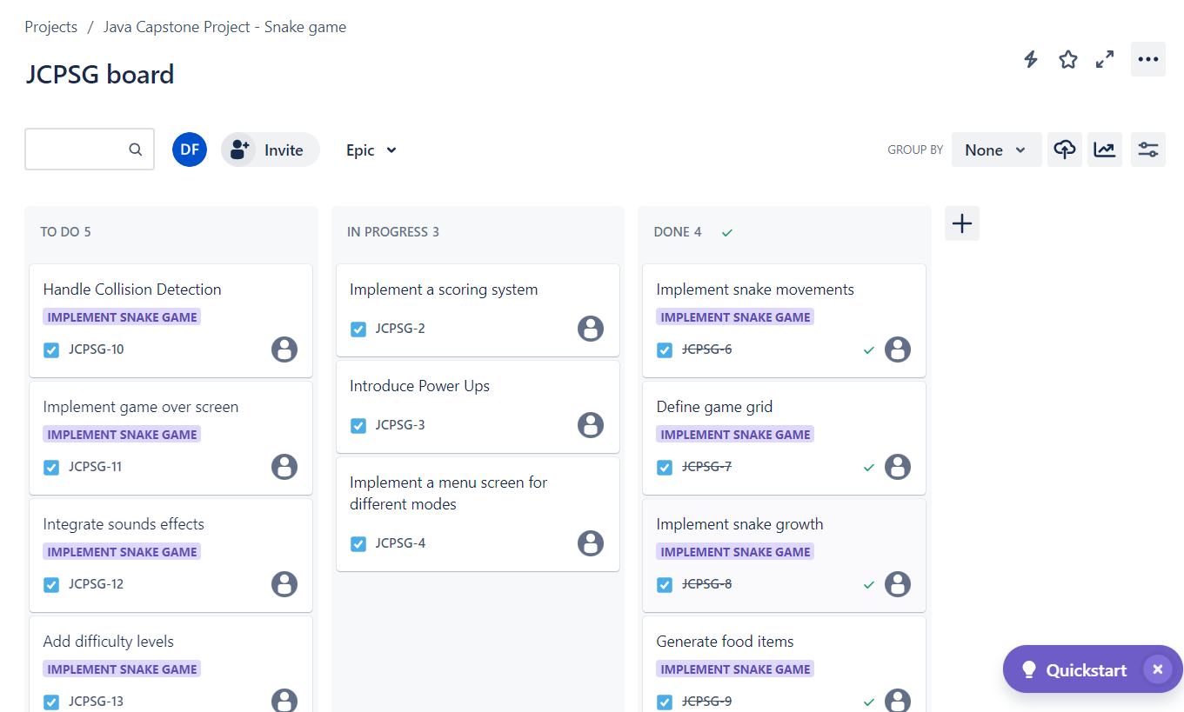

Slide 7
03
Design Algorithm
Let’s see my pseudocode

Slide 8
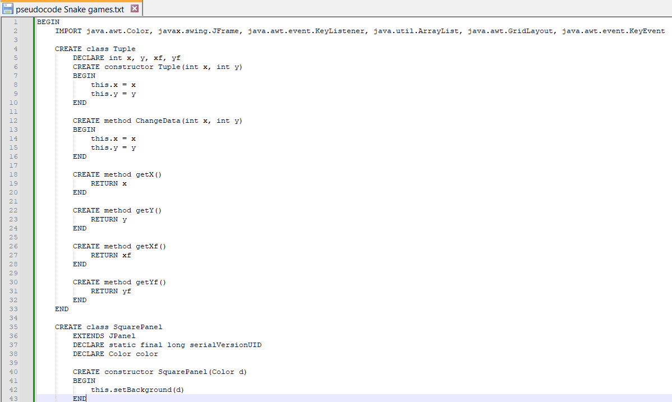
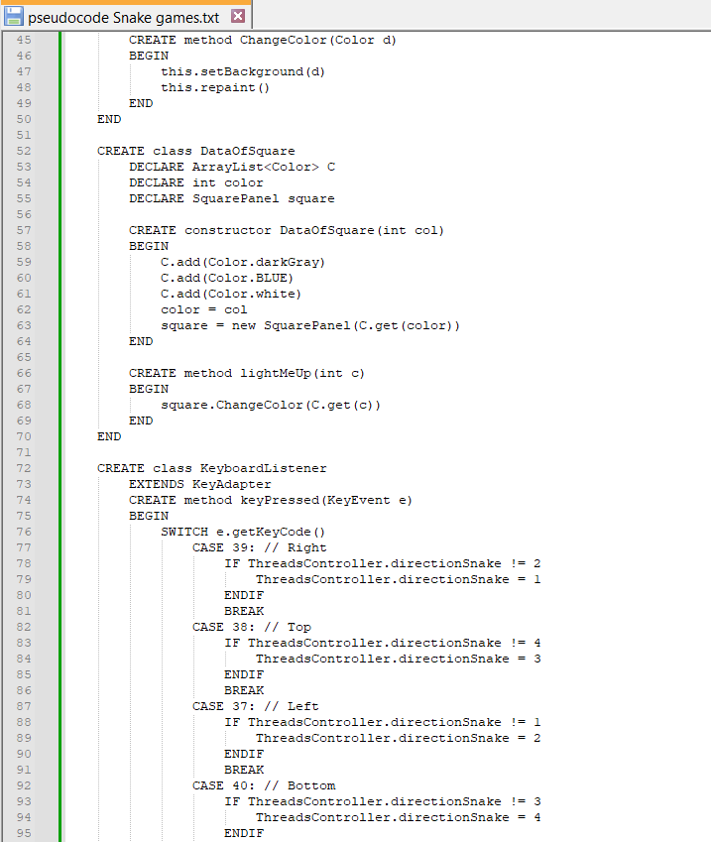

Slide 9
04
Product
See my product

Slide 10
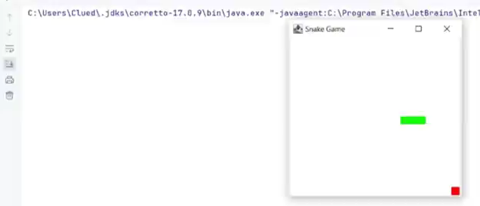

Product

Slide 11
Thanks!
Q
&
A

